Slide 1
CAP275: Data Communication and Networking Unit-2: Physical Layer
Dr. Manmohan Sharma
School of Computer Applications
Lovely Professional University

Slide 2
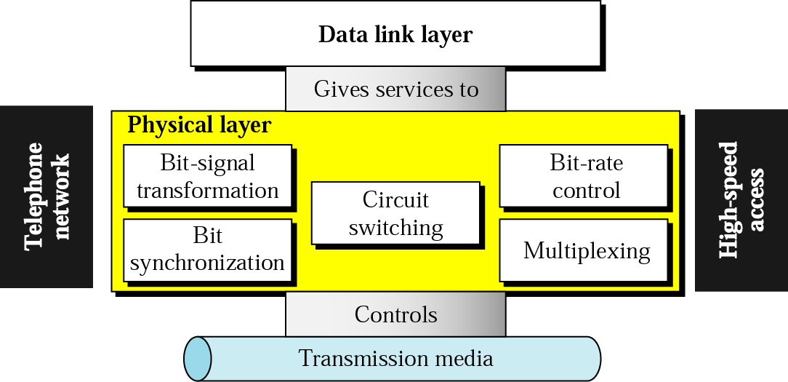
Physical Layer
The physical layer is the layer that actually interacts with the transmission media, the physical part of the network that connects network components together.
This layer is involved in physically carrying information from one node in the network to the next node in the network.
The physical layer has complex tasks to perform. One major task is to provide services for the data link layer.

Slide 3
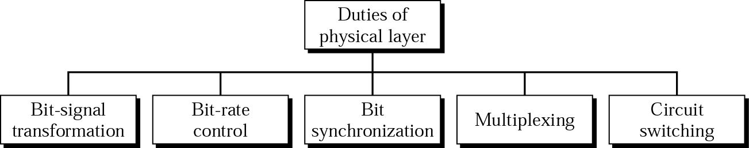
Services of Physical Layer

Slide 4
Data and Signals
The data in the data link layer consists of 0s and 1s organized into frames that are ready to be sent across the transmission medium.
This stream of 0s and 1s must first be converted into another entity: signals. One of the services provided by the physical layer is to create a signal that represents this stream of bits.
The physical layer must also take care of the physical network, the transmission medium. The transmission medium is a passive entity; it has no internal program or logic for control like other layers. The transmission medium must be controlled by the physical layer.
The physical layer decides on the directions of data flow. The physical layer decides on the number of logical channels for transporting data coming from different sources.
“To be transmitted, data must be transformed to electromagnetic signals.”

Slide 5
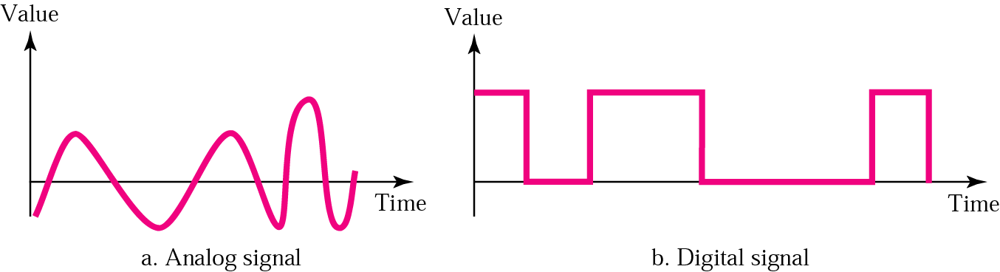
Signals can be analog or digital. Analog signals can have an infinite number of values in a range; digital signals can have only a limited number of values.

Slide 6
Periodic and Aperiodic Signals
In data communication, we commonly use periodic analog signals and aperiodic digital signals.

Slide 7
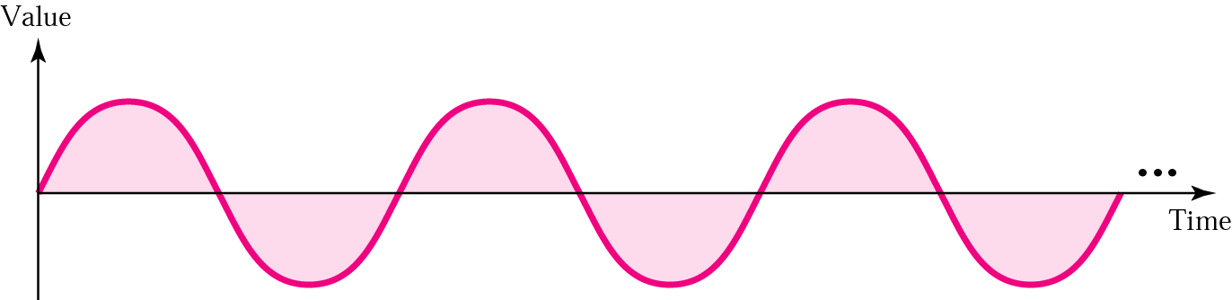
ANALOG SIGNALS
Periodic analog signals can be classified as simple or composite.
A simple periodic analog signal, a sine wave, cannot be decomposed into simpler signals.
A composite periodic analog signal is composed of multiple sine waves.

Slide 8
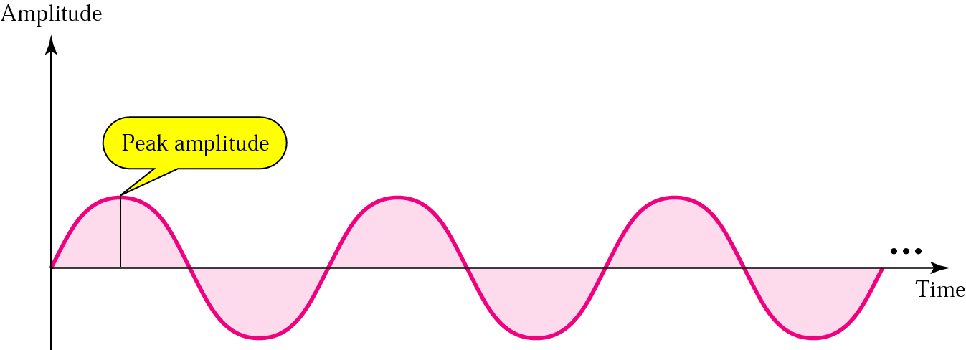
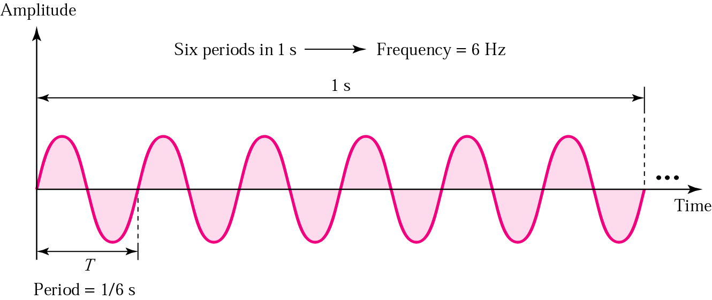

Slide 9
Frequency is the rate of change with respect to time. Change in a short span of time means high frequency. Change over a long span of time means low frequency.
If a signal does not change at all, its frequency is zero. If a signal changes instantaneously, its frequency is infinite.

Slide 10
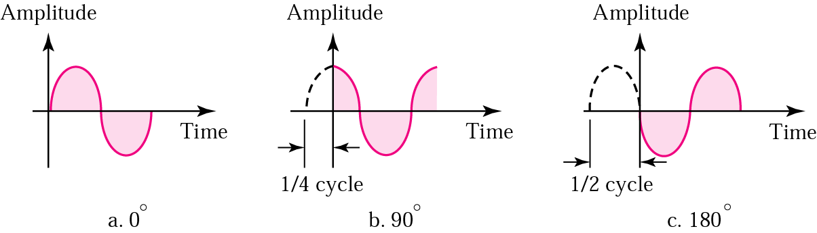
Phase describes the position of the waveform relative to time zero.

Slide 11
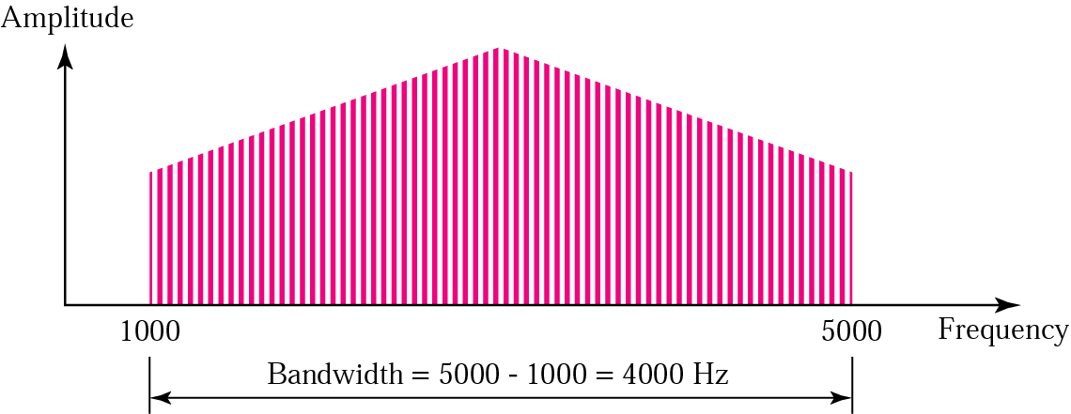
The bandwidth is a property of a medium: It is the difference between the highest and the lowest frequencies that the medium can satisfactorily pass.

Slide 12
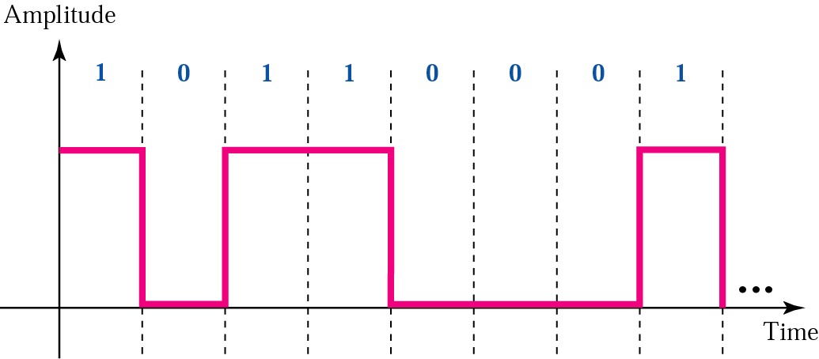
Digital Signals
A digital signal is a composite signal with an infinite bandwidth.

Slide 13
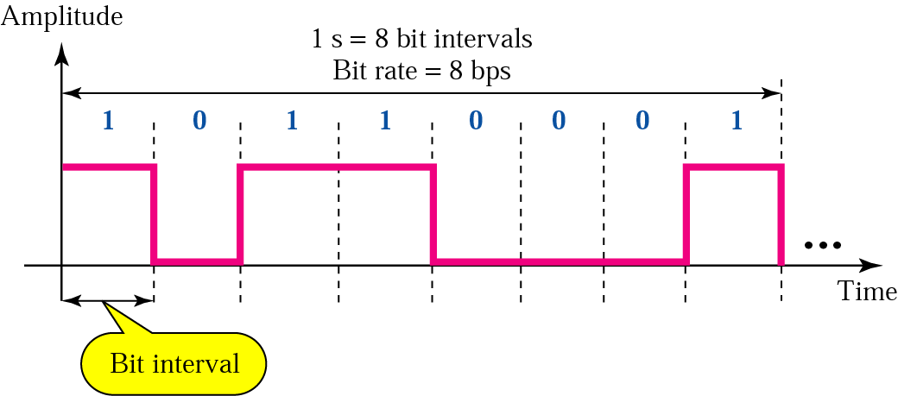

Slide 14
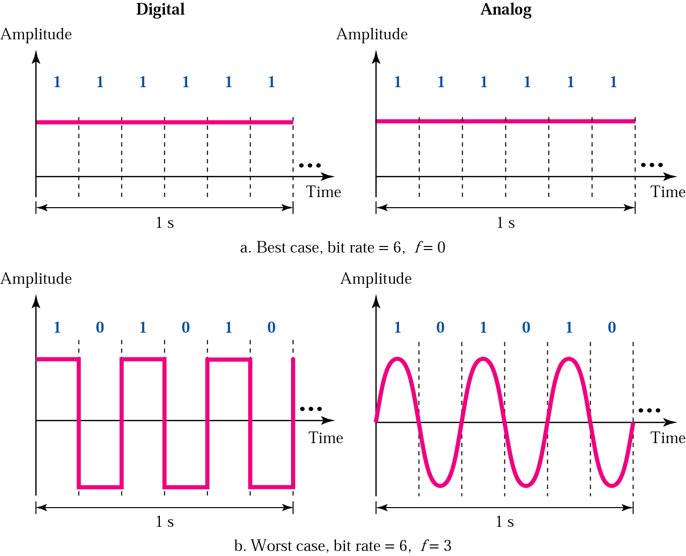
Digital v/s Analog

Slide 15
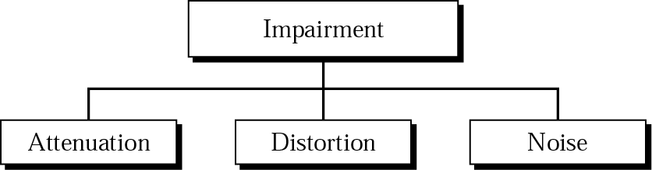
Transmission Impairment
Attenuation
Distortion
Noise

Slide 16
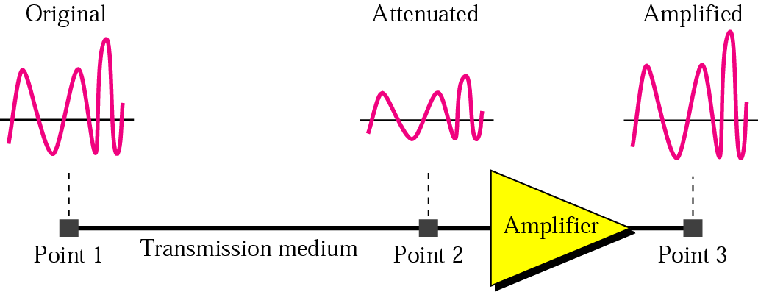
Attenuation

Slide 17
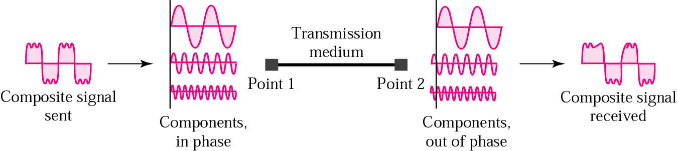
Distortion

Slide 18
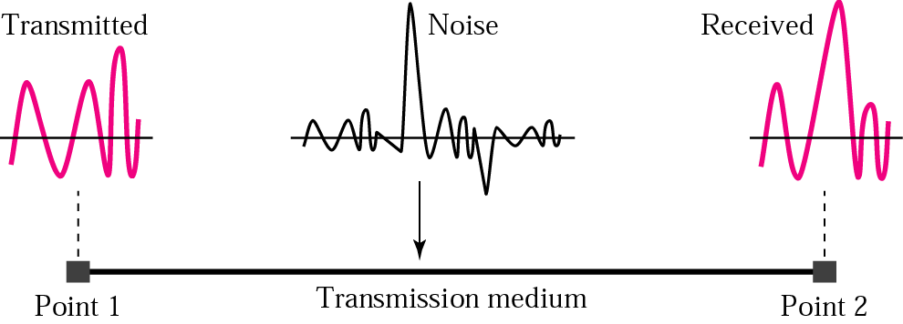
Noise

Slide 19
3.7 More About Signals
Throughput
Propagation Speed
Propagation Time
Wavelength

Slide 20
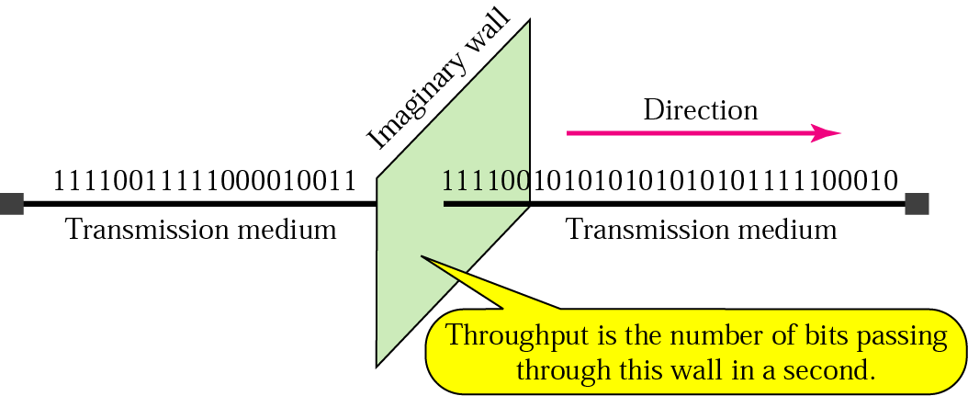
Figure 3.25 Throughput

Slide 21
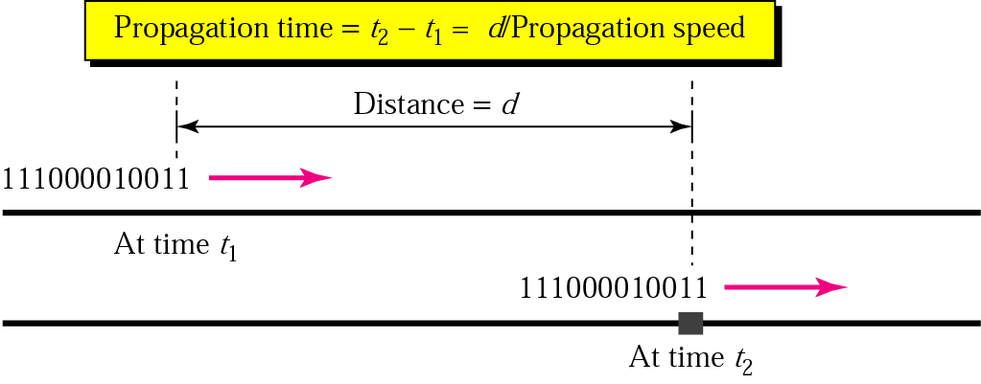
Figure 3.26 Propagation time

Slide 22
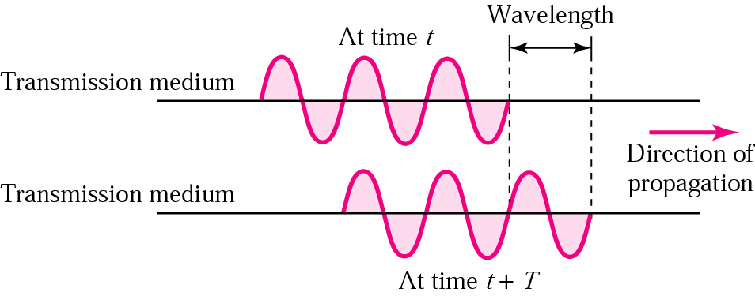
Figure 3.27 Wavelength

